Slide 1

PLACES IN TOWN
WHERE IS THE HOTEL?
THE ANSWERS
Rui Ventura

Slide 2


PLACES IN TOWN
WHERE IS THE HOTEL? THE ANSWERS
professorruiventura
professorruiventura

Slide 3
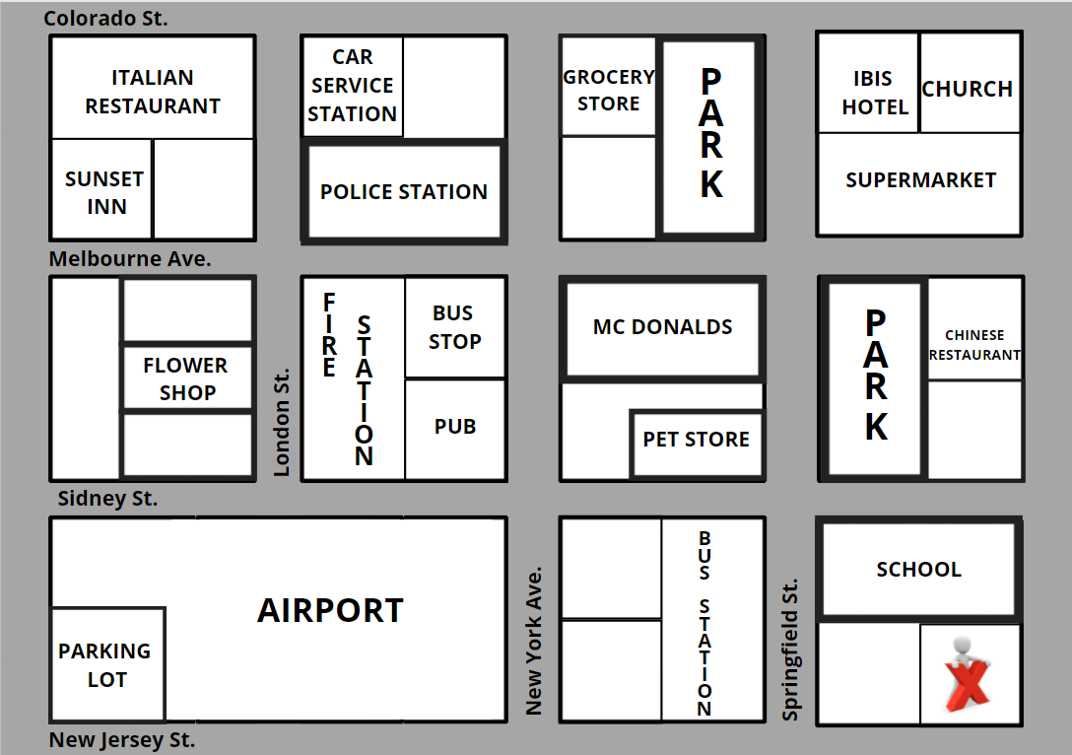
PLACES IN TOWN
WHERE IS THE HOTEL? THE ANSWERS
1 - Where is the grocery store?
The grocery store is on New York Ave.
The grocery store is on Colorado St.
BUTCHERY
LIBRARY

Slide 4
PLACES IN TOWN
WHERE IS THE HOTEL? THE ANSWERS
2 - Where is the church?
The church is on Colorado St.
The church is next to Ibis hotel.
BUTCHERY
LIBRARY

Slide 5
PLACES IN TOWN
WHERE IS THE HOTEL? THE ANSWERS
3 - Where is the bus station?
The bus station is on Springfield St. / on New Jersey St. / Sidney St.
The bus station is on the corner of Springfield and New Jersey. / Sidney and Springfield.
The bus station is across from the pet store. / across from the school
BUTCHERY
LIBRARY

Slide 6
PLACES IN TOWN
WHERE IS THE HOTEL? THE ANSWERS
4 - Where is the school?
The school is on Springfield St. / Sidney St.
The school is on the corner of Springfield and Sidney.
The school is across from the bus station. / across from the park.
BUTCHERY
LIBRARY

Slide 7
PLACES IN TOWN
WHERE IS THE HOTEL? THE ANSWERS
5 - Where is the butchery?
The butchey is on Melbourne Ave. / on Lndon St.
The butchey is on the corner of Melbourne Ave. and London St.
The butchey is across from the fire station.
The butchey is next to the flower shop.
BUTCHERY
LIBRARY

Slide 8
PLACES IN TOWN
WHERE IS THE HOTEL? THE ANSWERS
6 - Where is the Italian restaurant?
The Italian restaurant is on Colorado St. / on Lndon St.
The Italian restaurant is on the corner of Colorado St. and Lndon St.
The Italian restaurant is across from the car service station.
BUTCHERY
LIBRARY

Slide 9
PLACES IN TOWN
WHERE IS THE HOTEL? THE ANSWERS
6 - Where is the Chinese restaurant?
The Chinese restaurant is on Melbourne Ave.
The Chinese restaurant is across from the supermarket.
The Chinese restaurant is next to the park.
BUTCHERY
LIBRARY

Slide 10
PLACES IN TOWN
WHERE IS THE HOTEL? THE ANSWERS
7 - Where is the police station?
The police station is on Melbourne Ave. / on Lndon St. / on New York Ave.
The police station is on the corner of Melbourne Ave. and London St. / on the corner of Melbourne. and New York.
The police station is on Melbourne Ave. between London St. and New York Ave.
The police station is across from the fire station and the bus atop.
BUTCHERY
LIBRARY

Slide 11
PLACES IN TOWN
WHERE IS THE HOTEL? THE ANSWERS
8 - Where is the car service station?
The car service station is on Colorado St. / on Lndon St.
The car service station is on the corner of Colorado St. and London St.
The car service station is across from the Italian restaurant.
The car service station is next to the police station.
BUTCHERY
LIBRARY

Slide 12
PLACES IN TOWN
WHERE IS THE HOTEL? THE ANSWERS
9 - Where is pet store?
The pet store is on Srpingfield St. / on Sidney St.
The pet store is on the corner of Sidney St. and Springfield St.
The pet store is across from the bus station. / across from the park.
BUTCHERY
LIBRARY

Slide 13
PLACES IN TOWN
WHERE IS THE HOTEL? THE ANSWERS
10 - Where is the parking lot?
The parking lot is in the airport.
The parking lot is on New Jersey St.
The parking lot is next to the airport.
BUTCHERY
LIBRARY

Slide 14

BONS ESTUDOS!

